Slide 1

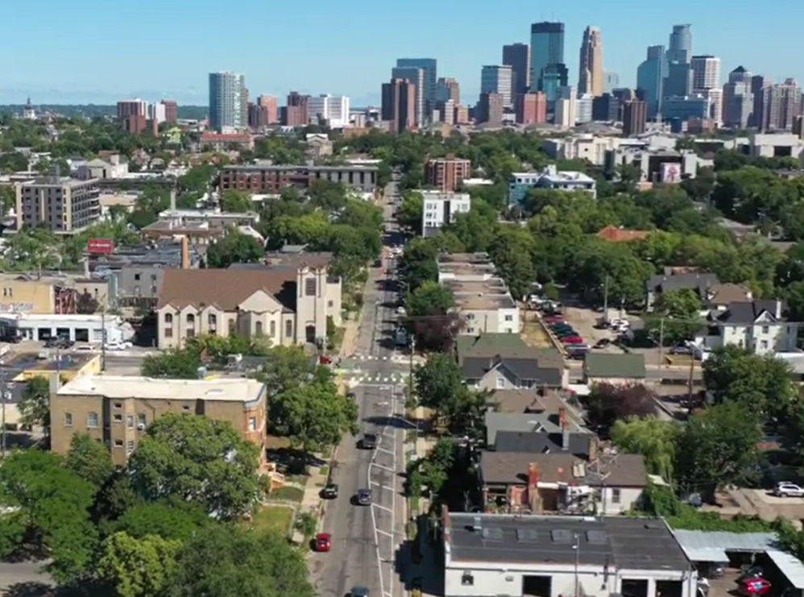

1st Ave S Reconstruction Project
E. Grant St – E. Franklin Ave.
Neighborhood Preconstruction Meeting
April 23rd, 2026

Slide 2
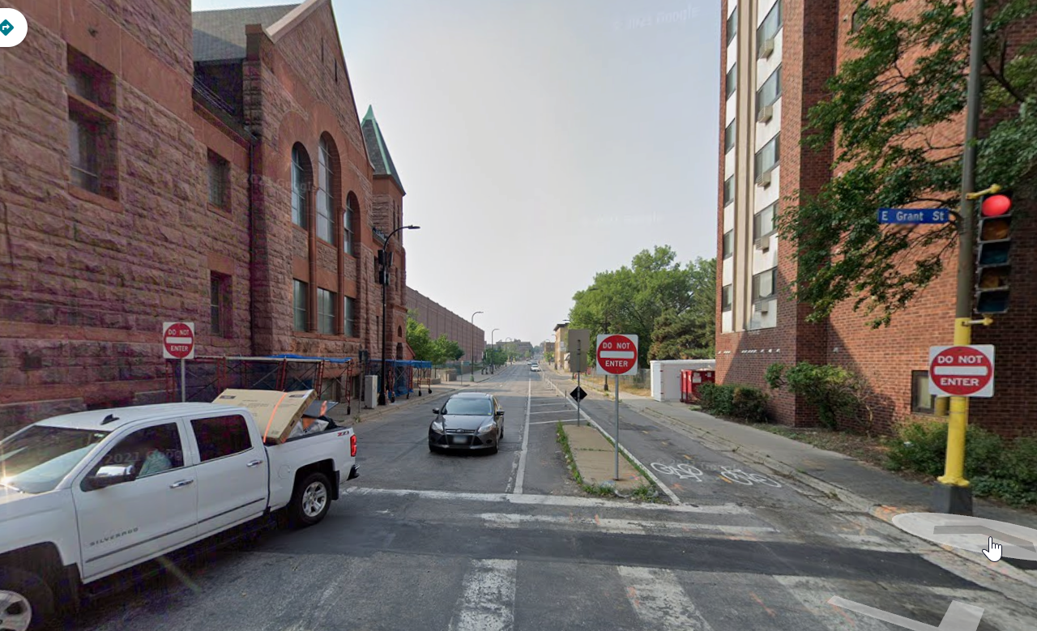
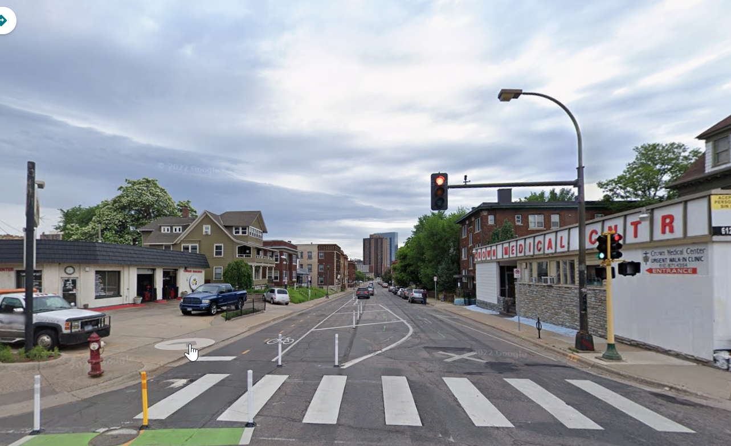
1st Ave S Reconstruction Project
Agenda
Welcome & Introductions
Project Description
Project Overview
Current Activities
Construction -What to Expect
Communications

Slide 3
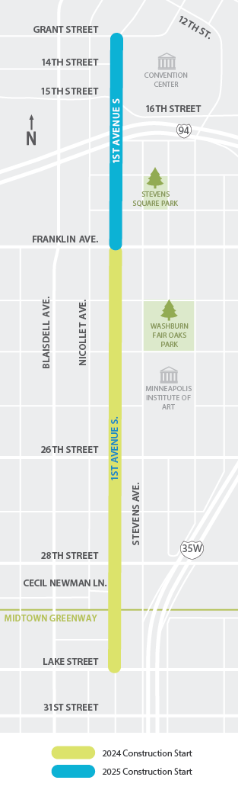
1st Ave S Reconstruction Project
Project Description
The City of Minneapolis Public Works Plans to reconstruct 1st Ave from Grant to Franklin Ave
Approximately 0.5 mile.
The final connection from Lake into downtown with a full corridor reconstruction
The segment from Lake St to Franklin completed in 2024/2025

Slide 4

Project Overview/ Process Background
We are here
Detail Design and Engineering
Construction
Preliminary design and Layout Approved
Public engagement began
2026
2022
2023
2024- 2025
1st Ave ( Lake to Franklin) construction completed in 2024/2025. Landscaping and other minor activities will be done this year.

Slide 5
1st Ave S Reconstruction Project
Proposed Changes to Roadway, Bike Lanes, and Sidewalks

Slide 6
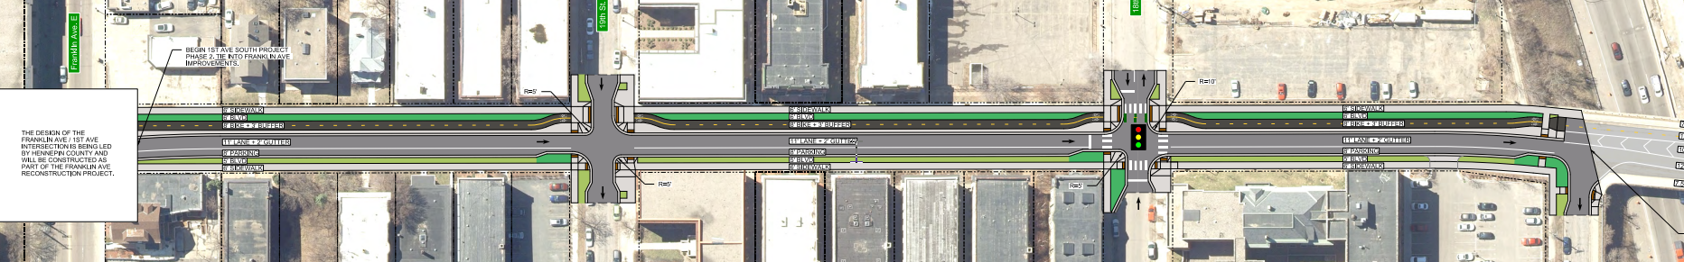
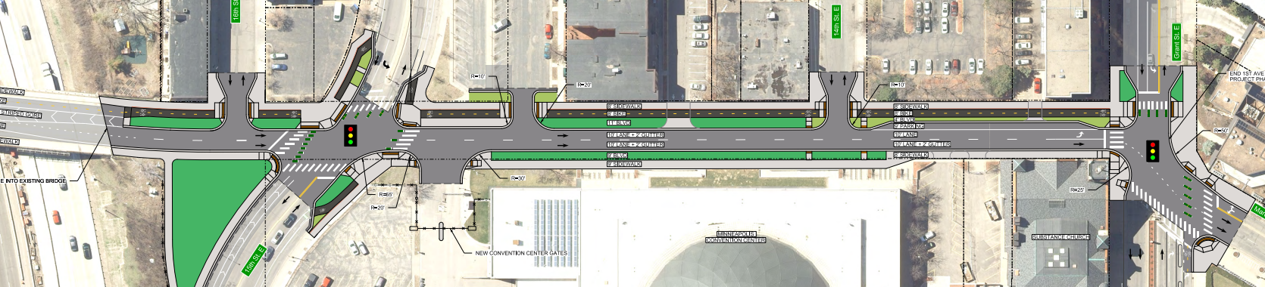
1st Ave S Reconstruction Project
Project Layout
Project Layout

Slide 7
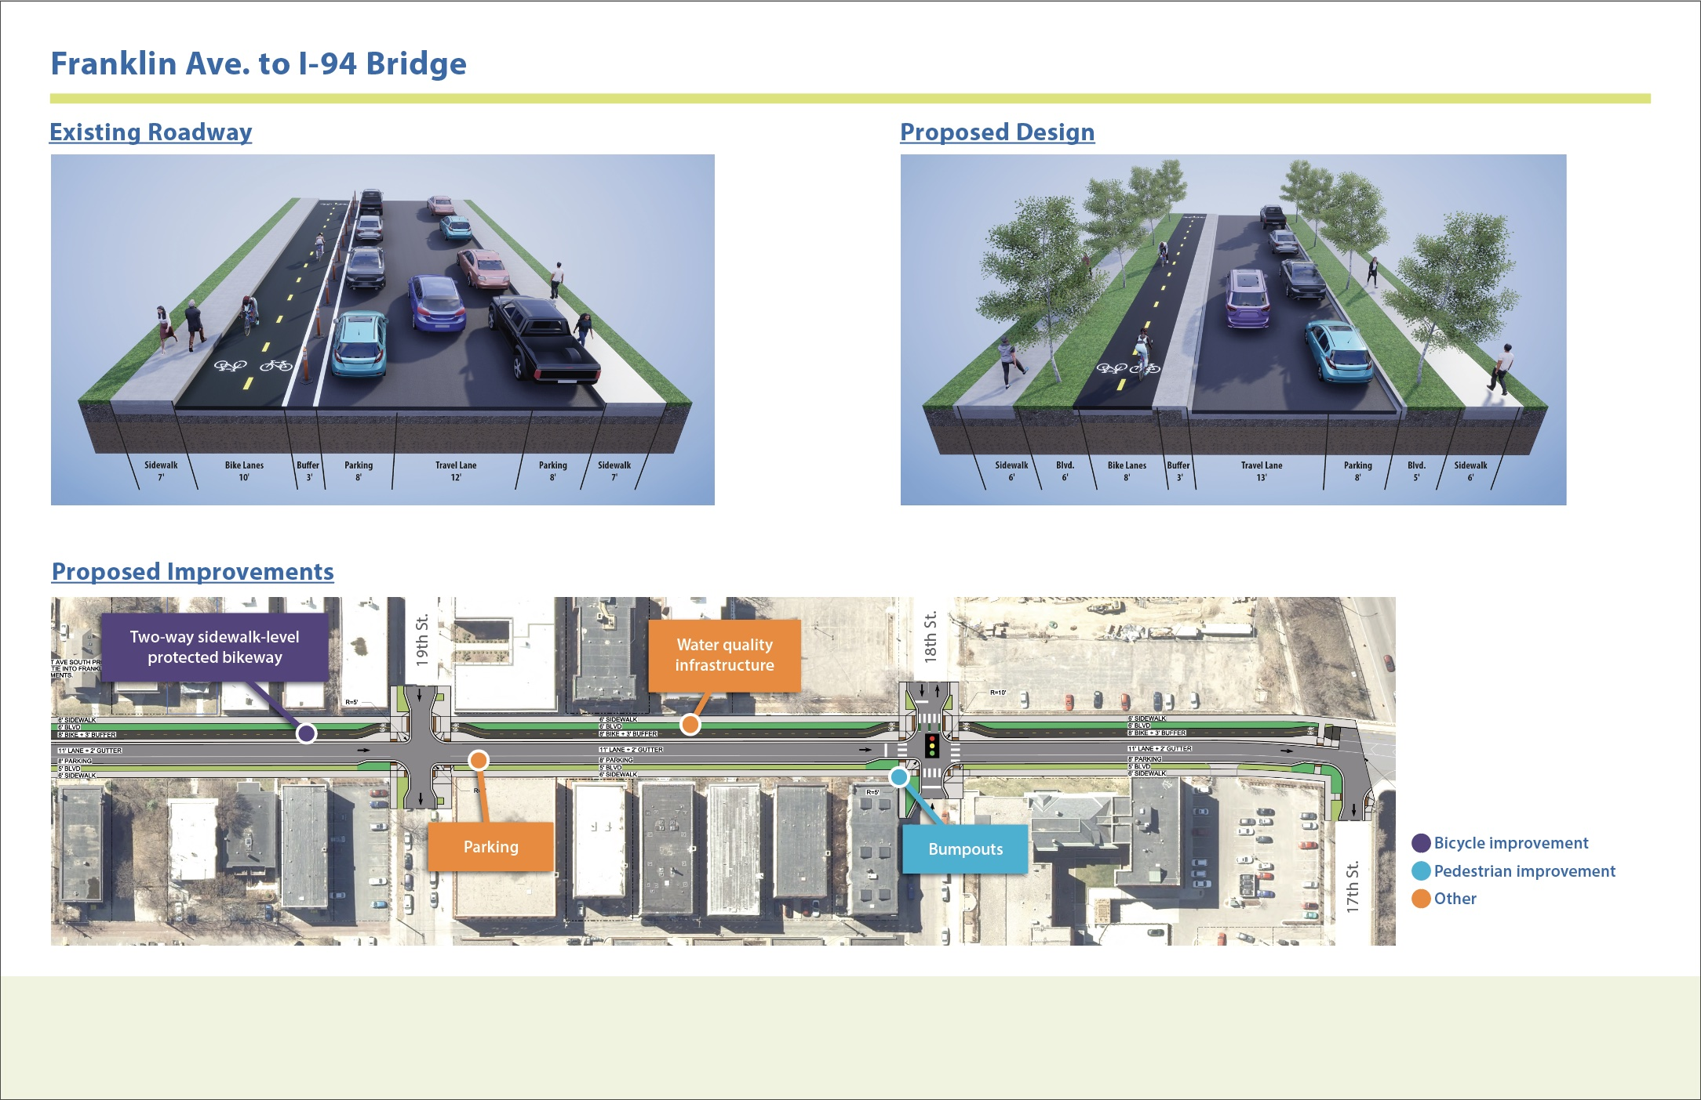

Slide 8
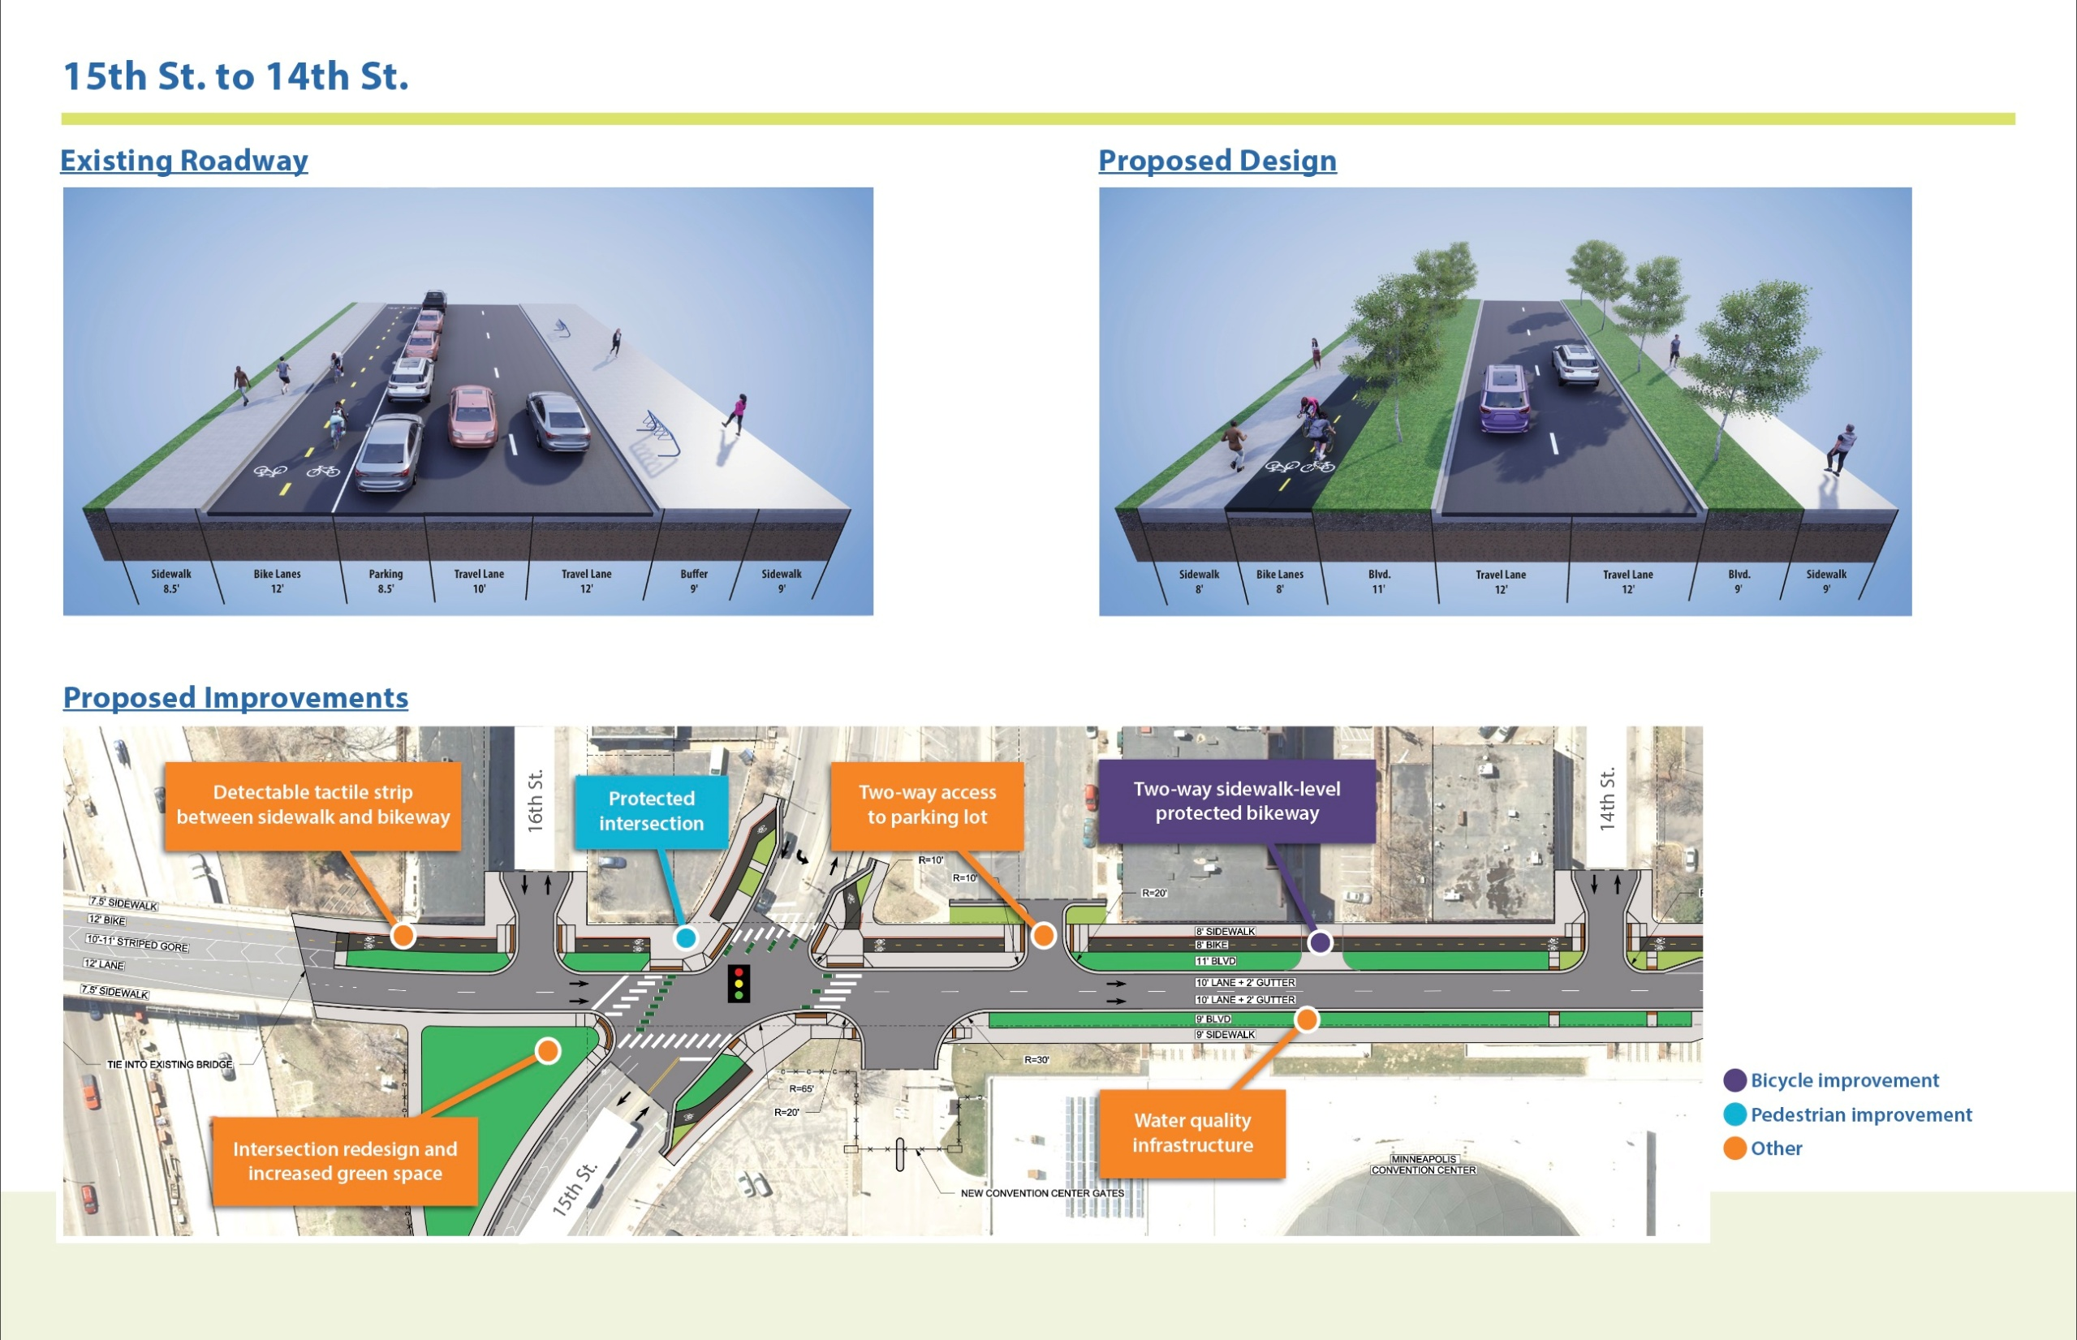

Slide 9
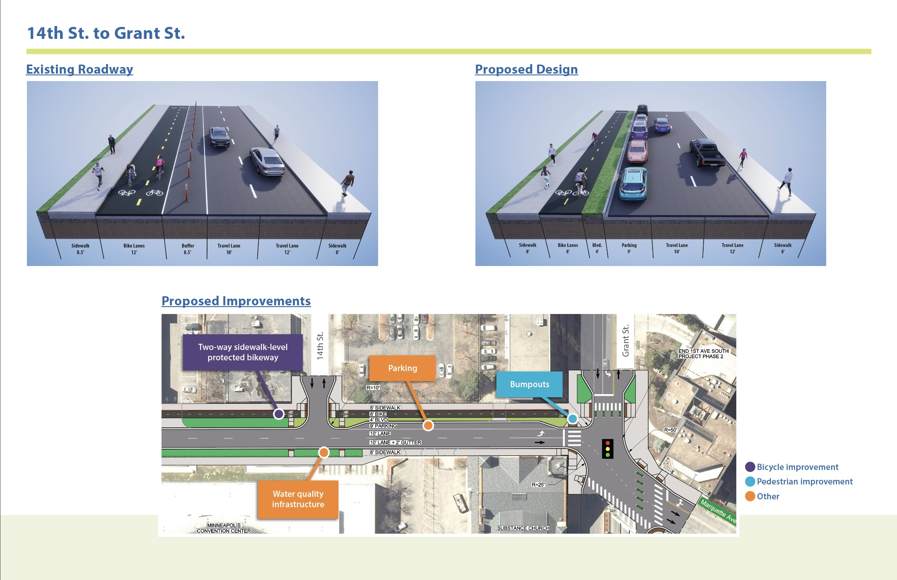

Slide 10
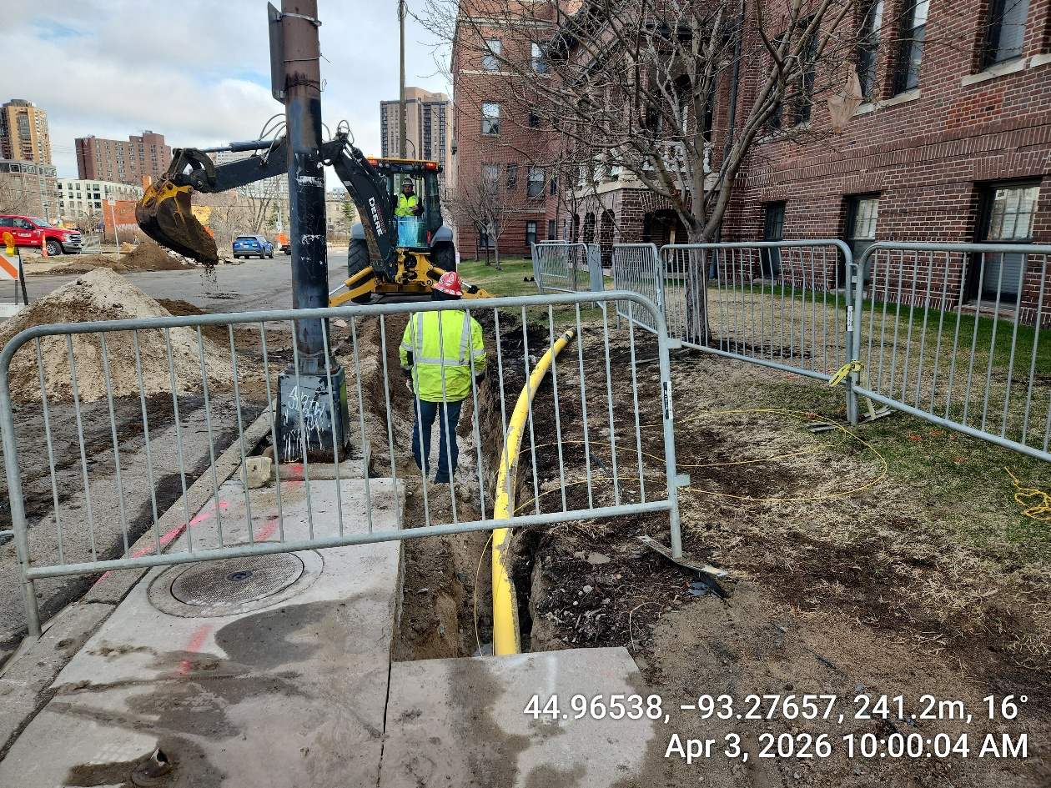
1st Ave S Reconstruction Project
Current Activities
CenterPoint Energy – Upgrading gas mains and service connection.
Grant to 94 Bridge: Completed
94 Bridge to Franklin: In progress
  To anticipate a few more weeks for services
  Centerpoint anticipates to be done in the week of 27th of April.
  To expect work with E 18th St. for Steel Pipe reroute that will be coordinated with City Contractor for 1st Ave S Reconstruction Project.
  Centerpoint Website: www.centerpointenergy.com/construction
    Stevens Square – Loring Heights Neighborhood
    Contact: (612) 542-6198 or mnconstruction@centerpointenergy.com

Slide 11
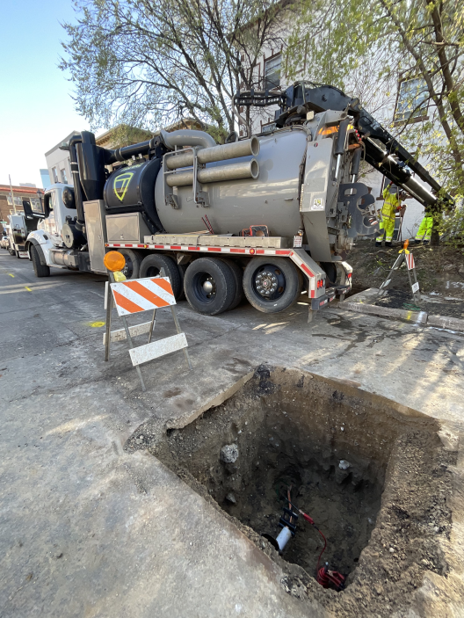
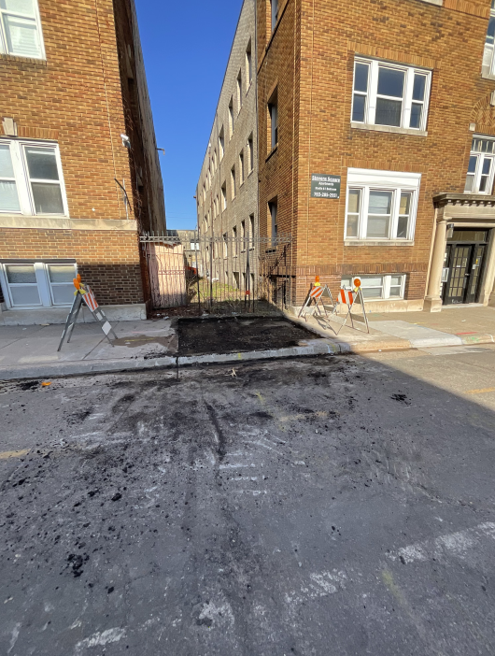
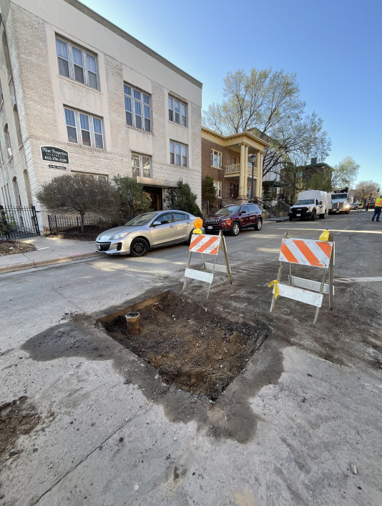
1st Ave S Reconstruction Project
  Centerpoint Gas’ Contractor (Michels Corporation) Activity – South of I-94 Bridge

Slide 12
1st Ave S Reconstruction Project
Construction- What to Expect
Roadway Construction Start date: April 27th, 2026
  Large Construction Equipment
  Disruption
  Noise
  Dust
  Parking Closures
  Temporary Pedestrian Ramps
  Traffic Impacts
  Business Access
  Construction Substantial Completion: November 15, 2026

Slide 13
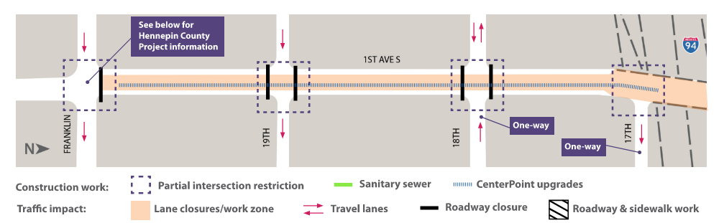
1st Ave S Reconstruction Project
Construction- What to Expect

Slide 14
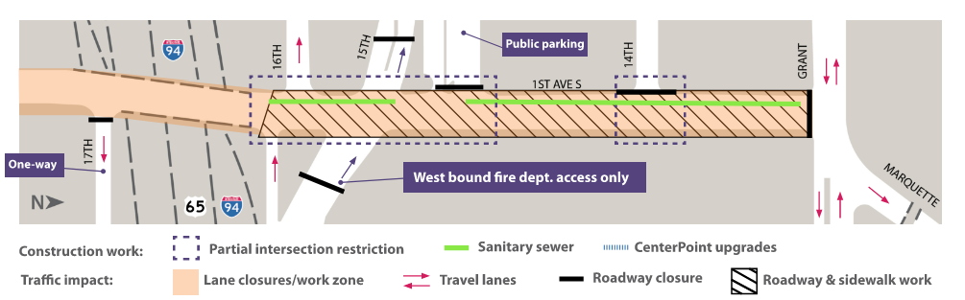
1st Ave S Reconstruction Project
Construction- What to Expect

Slide 15
1st Ave S Reconstruction Project
DETOUR ROUTES
(Vehicles, Bicycles and Pedestrians)

Slide 16
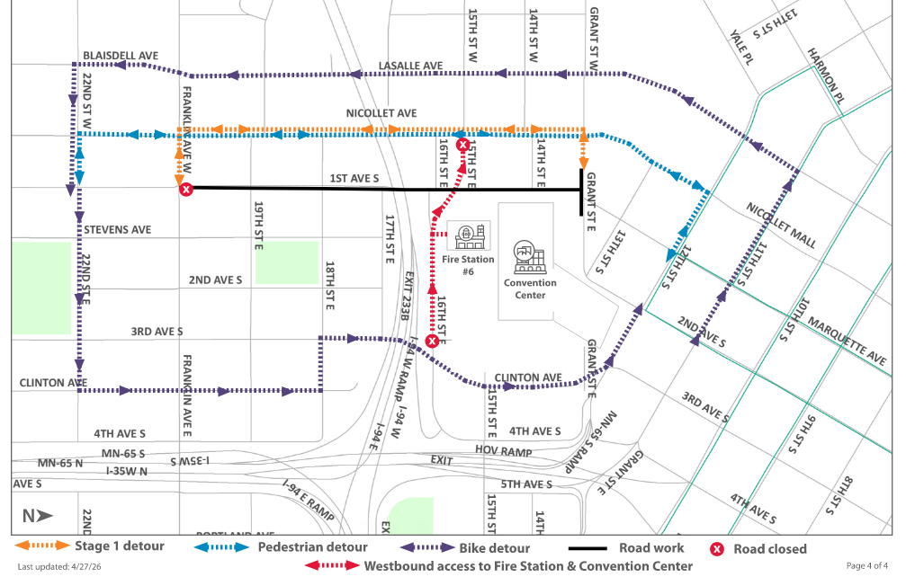
1st Ave S Reconstruction Project

Slide 17
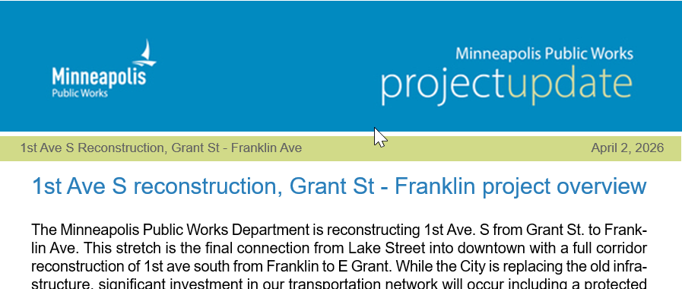

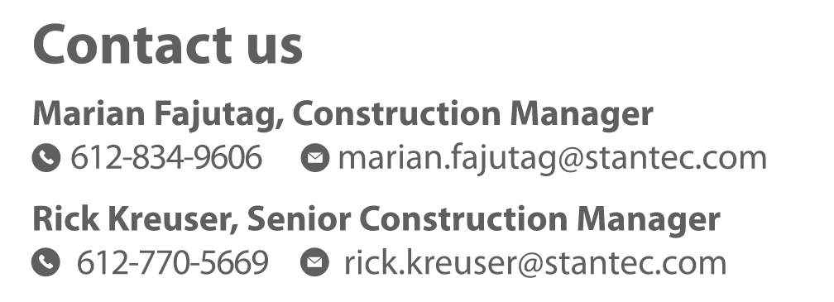
1st Ave S Reconstruction Project
Communications
Weekly Friday Meetings 10:00 am – 11:00 am
Weekly Email Updates (GovDelivery)
Neighborhood Meetings
One-on-One Site Visits
Website – Sign up for Updates, Project Engineer & Construction Manager Contact Information
https://www.minneapolismn.gov/government/projects/1st-ave-grant-st/

Slide 18
1st Ave S Reconstruction Project
Questions & Open Discussions

