Slide 1
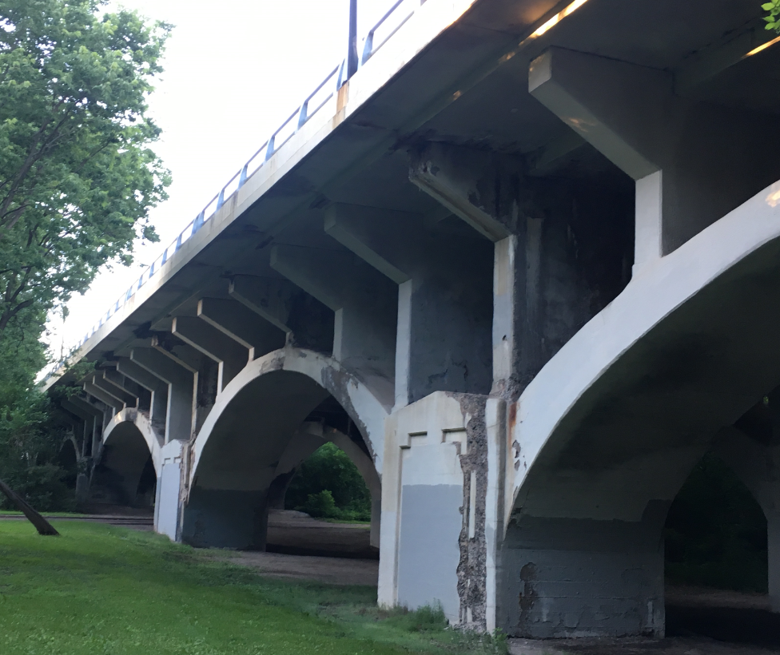
Bridge Components
Floor Beam
Spandrel Column
Arch Rib
Pier
This slide shows bridge components with its name terminology-
Bridge deck railing (superstructure) is supported by the floor beam
Load transfers from the floor beam
to the spandrel column, then to the arch rib
and to the pier and to the foundation
Which is supported by timber piles.

Slide 2
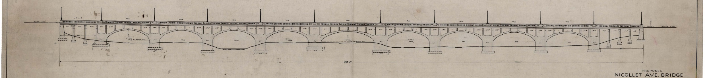
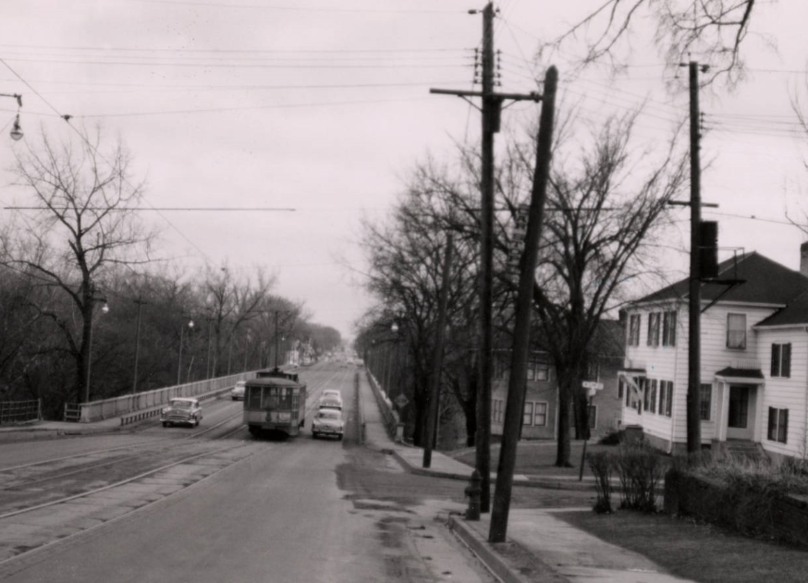
Bridge History
Constructed in 1923
Rehabilitated in 1973
Sidewalks widened and monuments added in 2002
Bridge is eligible for listing in the National Register of Historic Places
Nicollet Ave Bridge is the last 4 large open spandrel concrete Arch designed and built by the City of MPLS between 1914 to 1929.
The others are (Franklin Ave over Mississippi River rehabbed about 5 yrs ago, 3rd Ave over Mississippi River currently in the process of rehab by MnDOT, and the 10th Ave over Mississippi River completed last year by the same project team present today.

Slide 3
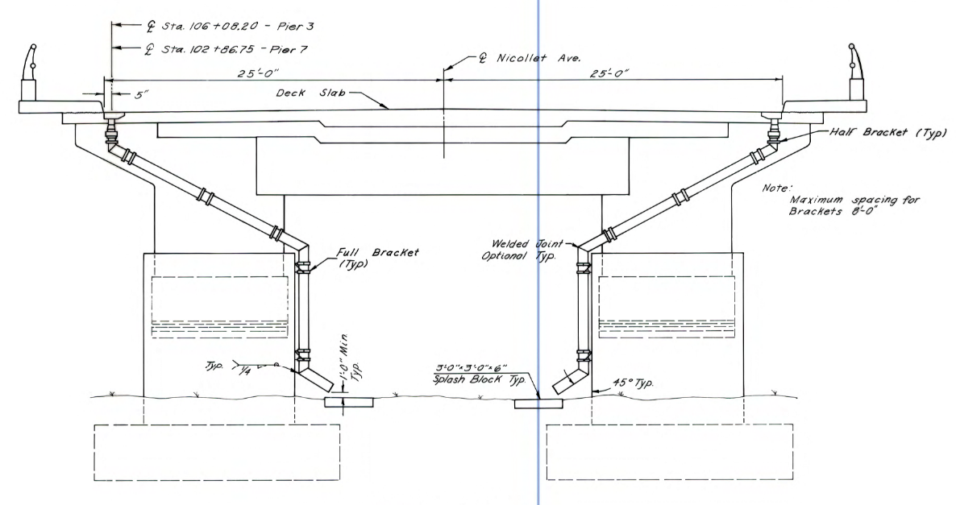
Proposed Bridge Repairs & Reconstruction
(Removals in Red)

Slide 4
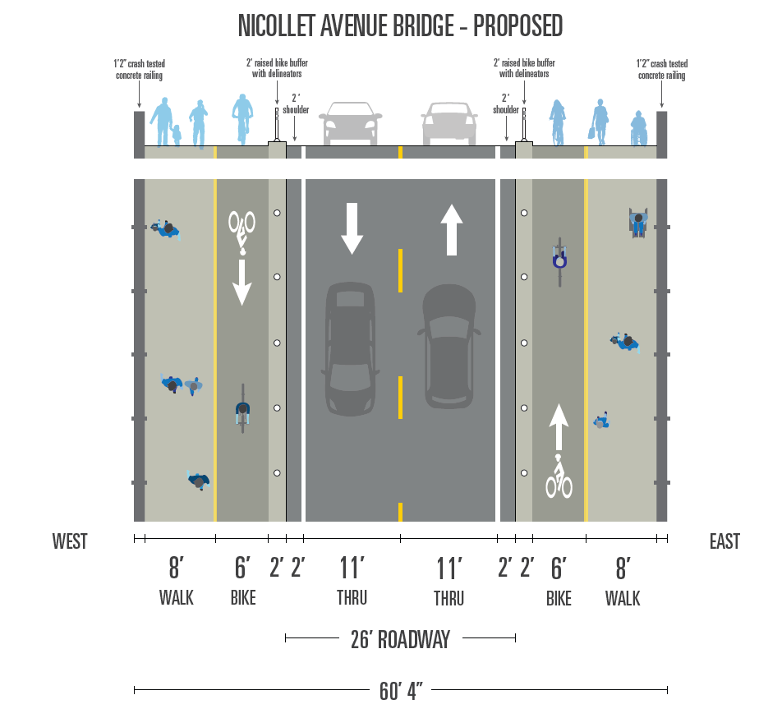
Proposed Bridge Cross Section

Slide 5
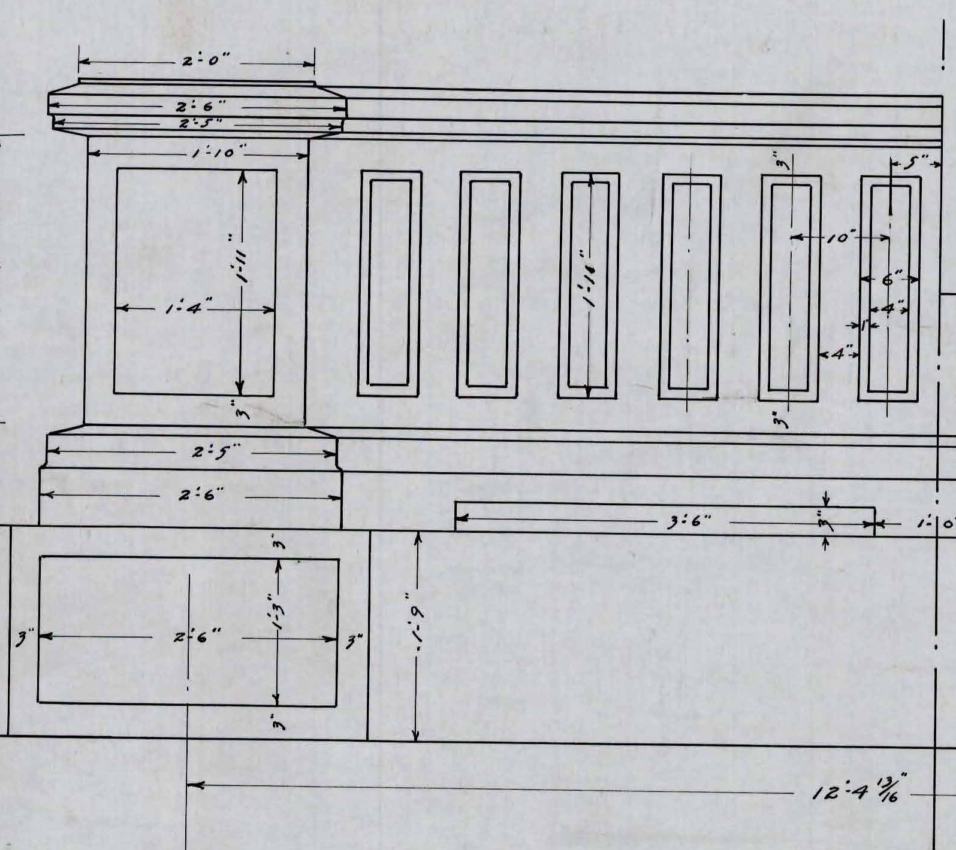

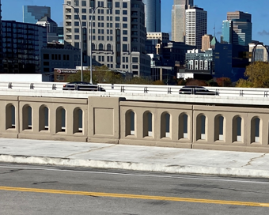
Bridge Railing
Similar to 10th Avenue Bridge (shown right)
Complements the original Nicollet Ave. railing (shown left)
Original
Existing
Recommended

